Slide 1
Standing Strong With High Schoolers
Presented by

Slide 2
Also Known As…

Slide 3
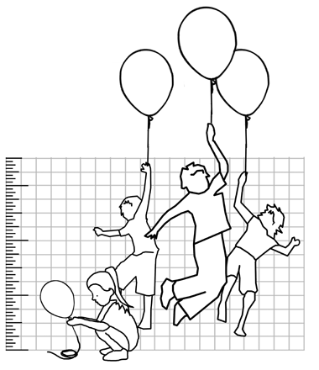
Bad News About Teenagers
Adolescence
Physical and hormonal growth spurts
unpredictable
Nocturnal creatures
Not thinking How can I make this easy for Mom and Dad?
Notes:
Youth culture
Psychological changes
Cognitive changes

Slide 4
Good News About Teenagers
Adolescence
Cognitive growth spurt
Reasoning powers
Moral development
The finish line is in sight
God-designed processes

Slide 5
Stand Strong
Moses answered the people, "Do not be afraid. Stand firm and you will see the deliverance the LORD will bring you today. The Egyptians you see today you will never see again. The LORD will fight for you; you need only to be still.“ (Exodus 14: 13-14)
Now then, stand still and see this great thing the LORD is about to do before your eyes! (I Samuel 12: 16)
You will not have to fight this battle. Take up your positions; stand firm and see the deliverance the LORD will give you, O Judah and Jerusalem. Do not be afraid; do not be discouraged. Go out to face them tomorrow, and the LORD will be with you. (2 Chronicles 20: 17)

Slide 6
The Rest of the Story…

Slide 7
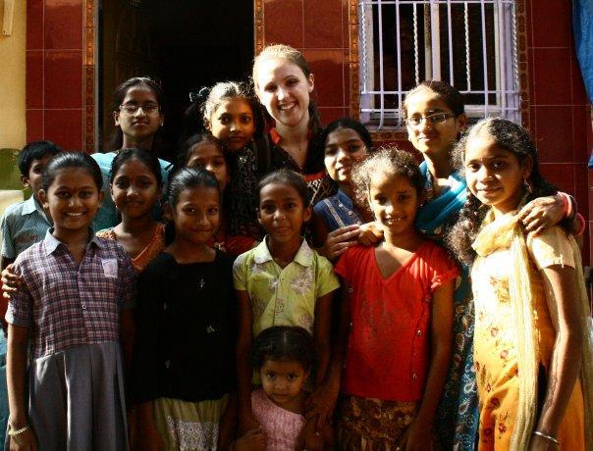
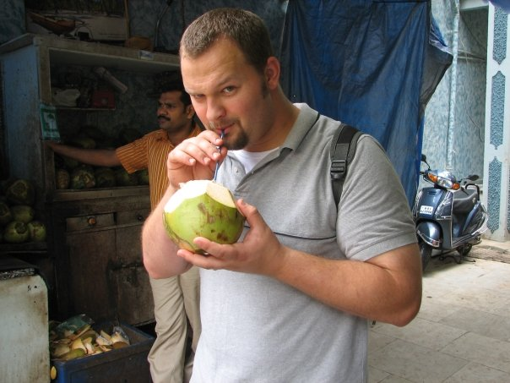
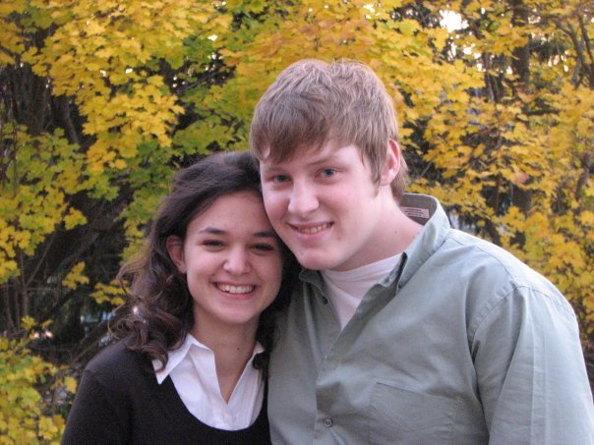
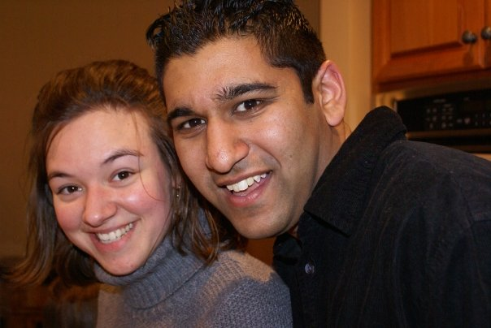

Slide 8
Academic Advantages
Focus
Acceleration
Remediation
Independence

Slide 9
Social Advantages
Positive Peer Group
Mentoring relationships with adults
Multi-generational context

Slide 10
Spiritual Advantages
Integration of faith, knowledge and moral integrity
Putting to death self-centeredness
Parents as disciplers and fellow believers in need of grace

Slide 11
BUT, What’s In It For ME?
Opportunities for God’s redemptive work in your life.
Opportunities for God’s grace to abound.
Opportunities to exercise faith and put to death unbelief.
Opportunities to know the Savior as you would not otherwise.

Slide 12
Stand Firm and See
Blessed is the woman who does not walk in the counsel of the wicked or stand in the way of sinners or sit in the seat of mockers. But her delight is in the law of the LORD, and on his law she meditates day and night. She is like a tree planted by streams of water, which yields its fruit in season and whose leaf does not wither. Whatever she does prospers.

